Slide 1

Lesson 6
Plan your time and objectives

Slide 2

TIME MANAGEMENT
Lesson 6 Plan your time and objectives
1/4
Book page 30
Threats to effective time management:
Lack of objectives.
Lack of clarity about the task.
Disorganisation.
Unforeseen crises or commitments.
Perfectionism.
Performance-debilitating circumstances.
Procrastination.
See exercise 2.1

Slide 3

Time management (continued)
Lesson 6 Plan your time and objectives
2/4
Book page 31
Effective time management includes:
Having clear objectives.
A good plan.
Classify tasks.
Use a timetable.
Don’t be distracted.
Focus on one thing.
Review each activity before you leave it.
Reward yourself.
See exercise 2.2
Reward yourself.

Slide 4
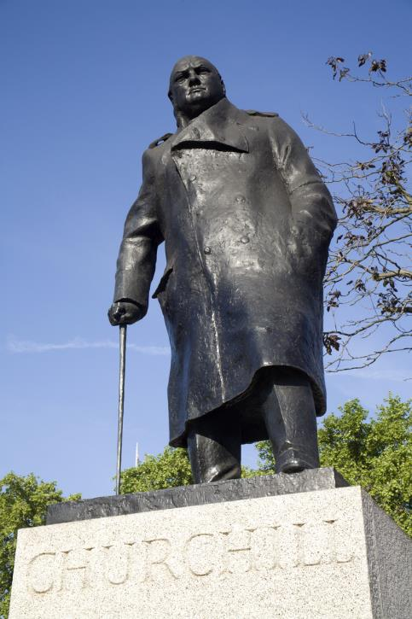
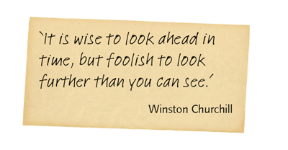
Setting your aims and objectives
Lesson 6 Plan your time and objectives
3/4
Book pages 32–33
SMART
S specific
M measurable
A achievable
R realistic
T timed
A agreed
See exercise 2.3

Slide 5
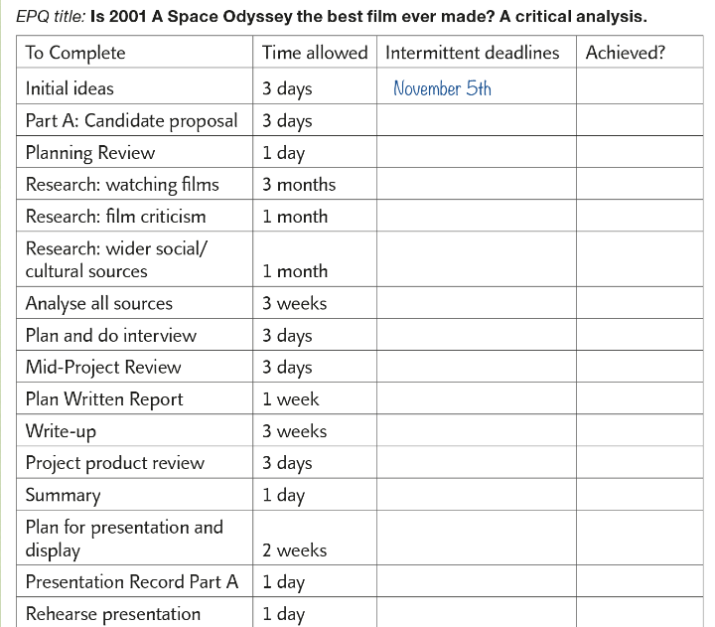
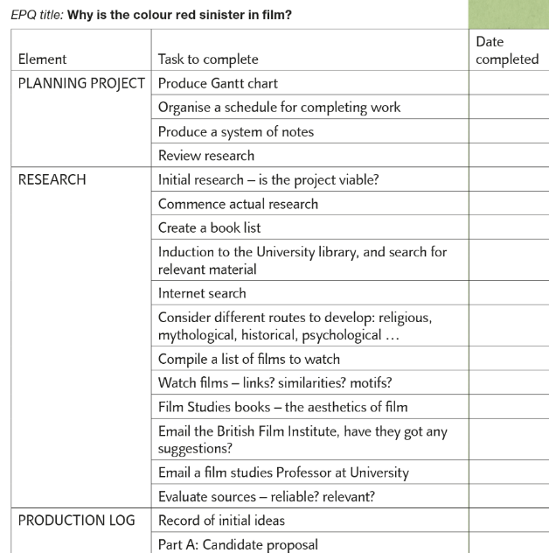
Making a general plan
Lesson 6 Plan your time and objectives
4/4
Book pages 34–35
It is more difficult making a plan for 90 hours of work than for short deadlines.
Exemplar 1
List all the tasks.
‘Slack’ time built in.
‘Achieved’ column.
Exemplar 2
Lists all the sections.
Tasks within the section.
Exemplar 1: Part of Rosie's plan.
Exemplar 2: Part of Jack's plan.

Slide 6
Lesson 7
Communicating changes

Slide 7

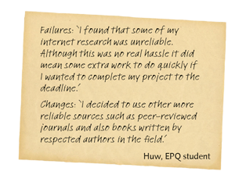
Where these are communicated
Lesson 7 Communicating changes
1/1
Book pages 36–37
AQA forms revisited, to see how changes were communicated:
RECORD OF INITIAL IDEAS
PLANNING REVIEW
MID-PROJECT REVIEW
PROJECT PRODUCT REVIEW
See exercise 2.4

Slide 8
Lesson 8
Additional management tools

Slide 9
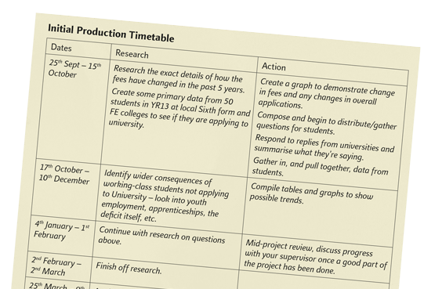
Production of timelines and diary of progress
Lesson 8 Additional management tools
1/3
Book pages 38–39
These are optional extras.
Excellent evidence of management.
Do not make the mistake of thinking that ‘the more I write, the better Grade I will get’.
Options:
Initial production timetable.
Secondary production timetable.
Diary of progress.
Diary of issues.
Final production timetable.
Part of Megan's planning.

Slide 10
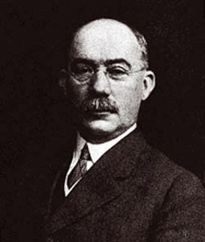
Gantt chart
Lesson 8 Additional management tools
2/3
Book pages 40–41
Shows the timing of each task.
Column 1: A list of activities.
Row 1: A suitable time scale.
A bar represents each activity.
Length of bar represents start,
duration and end date.
See exercise 2.5
Gantt, an American engineer.

Slide 11
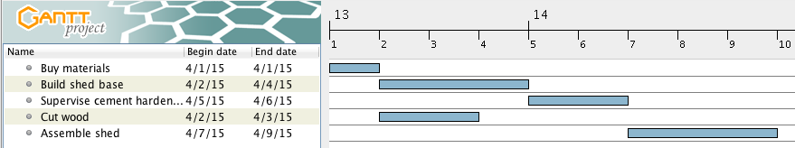
PERT chart
Lesson 8 Additional management tools
3/3
Book pages 42–43
Identifies the critical path for a project.
PERT chart shows the relationship between the activities of your project.
Looks at the time needed to complete each task.
Shows the sequences in which the tasks will take place.
See exercise 2.6
GANTT chart for same kind of project building a shed.

Slide 12
Lesson 9
Dealing with data

Slide 13
Primary and secondary data
Lesson 9 Dealing with data
1/2
Book page 46
Primary data
Data collected first hand from your own research.
No requirement to use primary data in your study.
Secondary data
Data collected by someone else.
Your literature review collects secondary data.

Slide 14

Quantitative and qualitative data
Lesson 9 Dealing with data
2/2
Book page 47
Quantitative data
How much, i.e. quantity.
Summarised using measures of central tendency and dispersion and graphs.
Qualitative data
Non-numerical, e.g. words or pictures.
Analysed thematically.
Can count the number of times a word is used, becomes quantitative.
See exercise 3.1
A picture can be described quantitatively or qualitatively.

Slide 15
Lessons 10 & 11
Collecting primary data

Slide 16

Identifying ethical issues
Lessons 10 & 11 Collecting primary data
1/7
Book pages 48–49
A conflict between what a researcher wants and the rights of the participant.
Informed consent.
Deception.
Right to withdraw.
Protection of participants.
Anonymity and confidentiality.
Privacy.
See exercise 3.2

Slide 17

Dealing with ethical issues
Lessons 10 & 11 Collecting primary data
2/7
Book pages 50–51
Before study: Gaining informed consent
Rationale.
Why participants selected.
Right to withdraw.
What they are required to do.
How data stored.
After study: Debriefing
Title of study.
Thank you.
Purpose of study, how findings used.
Rationale for any deception.
Confirm anonymity.
Right to withdraw data.
Enquire about any possible distress.
Your contact details.
See exercise 3.3

Slide 18
Sampling
Lessons 10 & 11 Collecting primary data
3/7
Book pages 52–53
Selecting a sample
Define target population.
Either use whole target population or aim to select a representative sample.
Probability sampling
Random.
Systematic.
Stratified.
See exercise 3.4
Non-probability sampling
Convenience.
Self-selected/volunteer.
Quota.
Snowball.

Slide 19
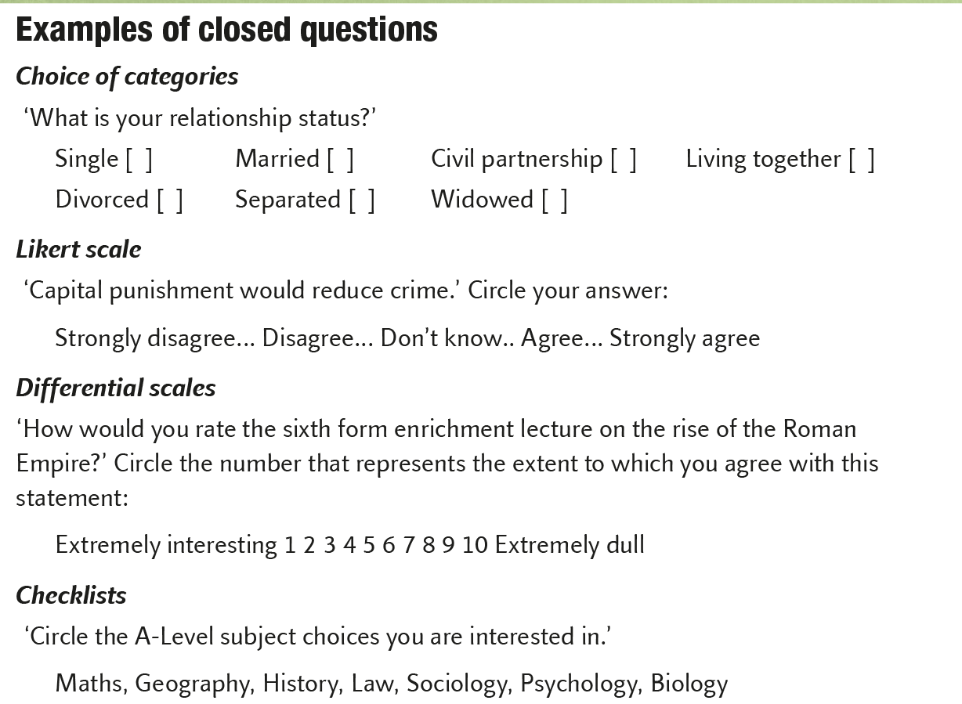
Self-report techniques
Lessons 10 & 11 Collecting primary data
4/7
Book pages 54–55
Questionnaire = fixed set of written questions.
Interview = interviewer can adapt questions.
Step 1 Developing good questions.
Clarity (e.g. jargon, double-barrelled, double negative).
Bias (leading questions).
Analysis (closed versus open questions).
Step 2 Design a good questionnaire.
Order of questions.
Variety.
Response set.
Filler questions.
Distribution.
See exercise 3.5

Slide 20

Self-report techniques (continued)
Lessons 10 & 11 Collecting primary data
5/7
Book pages 56–57
Step 3 Pilot study.
Stage 1:
  Select small representative sample.
  Test instructions, questions, equipment.
Stage 2: Make changes.
Step 4 Considering reliability and validity.
Internal reliability – split half.
External reliability – test-retest.
Internal validity – leading questions, social desirability bias.
External validity – population validity.
Step 5 Select sample.
See exercise 3.6

Slide 21
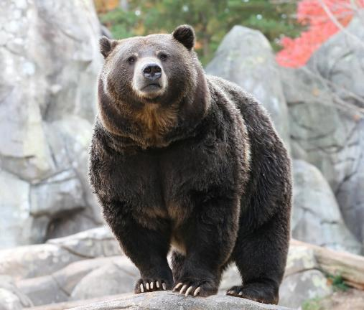
Observational techniques
Lessons 10 & 11 Collecting primary data
6/7
Book pages 58–59
Recording data, behavioural categories should:
Be clearly organised.
Cover all possible components.
Be mutually exclusive.
Sampling procedures
Event sampling.
Time sampling.
Other things about observations
Naturalistic and controlled.
Overt and covert.
Participant and non-participant.
See exercise 3.7
Looks like P3, see coding system in textbook.
Considering reliability and validity.
Content analysis.
Advantages and disadvantages of observations.

Slide 22

Other research methods
Lessons 10 & 11 Collecting primary data
7/7
Book pages 60–61
Not sure I can take any more!
Experiments:
  IV and DV.
  Observation or self-report to measure DV.
  Lab, field or natural/quasi.
  Extraneous/confounding variables.
  Ecological validity.
Correlations.
Investigations.
Case studies.
See exercise 3.8
Where to begin
Aims.
Hypothesis.
Operationalisation.
What happens at the end
Descriptive statistics.
Inferential statistics.

