Slide 1

Lessons 12 & 13
Full literature review

Slide 2

Secondary sources
Lessons 12 & 13 Full literature review
1/2
Book pages 62–63
Wikipedia.
The Internet.
  Cross check.
  Be selective.
  Peer-reviewed.
  Search engines.
  Record details (see table).
See exercise 3.9
3. Other credible sources:
  A-level textbooks.
  Books.
  Academic Journals.
  Newspaper articles.
  TV programmes.

Slide 3

Secondary data using different sources
Lessons 12 & 13 Full literature review
2/2
Book pages 64–65
Synthesising sources: A literature review.
Like a funnel.
Narrow to specific area.
Group items together.
Lead logically to aims.
What the literature review should NOT be.
A descriptive list.
Feelings.
Everything.
Irrelevant material, e.g. life story.
Example of a bad literature review and improved version.
See exercise 3.10

Slide 4
Lesson 14
Being analytical

Slide 5


METHODS OF ANALYSIS
Lesson 14 Being analytical
1/1
Book pages 66–67
Analysis = examine in detail but not descriptively –evaluate.
Analysis method 1: Considering conflicting arguments.
Example project: Jenny’s EPQ on Yellowstone
Analysis method 2: Considering the value of sources used.
Source.
Author’s background.
Date published, are the findings still relevant?
Depths of reviews.
Sources cited.
Objectivity.
Justification for reliability.
See exercise 3.11
See exercise 3.12

Slide 6
Lesson 15
Understanding peer review

Slide 7

Using peer reviewed journals
Lesson 15 Understanding peer review
1/2
Book page 68
Peer review
Academic journals.
Books.
The Internet.
How to use peer review when evaluating sources.
See exercise 3.13

Slide 8

Evaluating peer review
Lesson 15 Understanding peer review
2/2
Book page 69
The strengths of peer review
High quality research.
Controls amount of information.
Determines ownership of intellectual property.
Also:
Guards against plagiarism.
Guards against fraud.
The limitations of peer review
Finding an expert.
Anonymity versus open reviewing.
Preserves the status quo.
See exercise 3.14

Slide 9
Lesson 16
Avoiding plagiarism

Slide 10

Avoiding plagiarism
Lesson 16 Avoiding plagiarism
1/2
Book pages 70–71
Plagiarism = publication of someone else’s words, thoughts, ideas without permission or credit.
Rewriting
Make it your own.
Rewrite don’t cut and paste.
Paraphrasing and summarising.
See exercise 3.15
Using quotes
Credit the sources.
Credit ideas as well as words.
What about general knowledge?
How much should I quote?
Using long quotations.
Can I cut and paste a diagram from the Internet?
How much is too much?

Slide 11
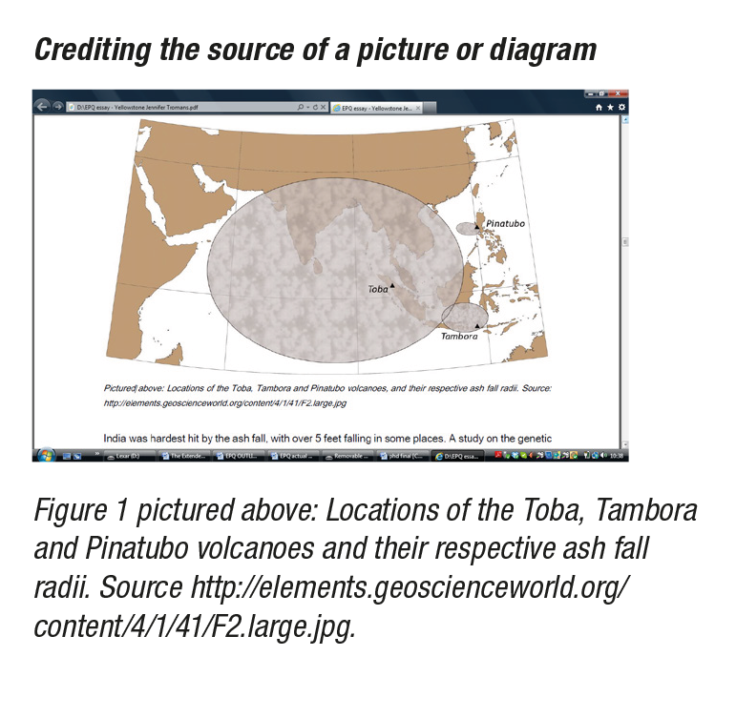
Extra
Lesson 16 Avoiding plagiarism
2/2
Book pages 72–73
Examples of how to quote.
Words to use.
Other issues:
More than one author.
Introducing a long quotation.
If you need to alter a quotation.
If you remove some text from a quotation.

Slide 12
Lesson 17
Preparing MID-PROJECT REVIEW

Slide 13
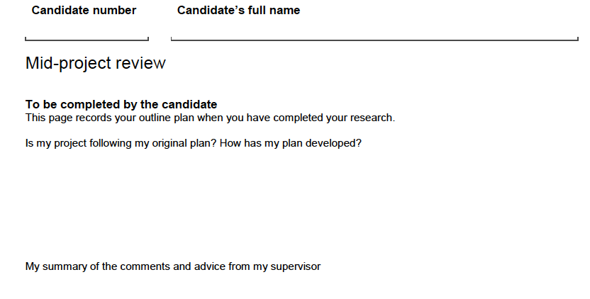
The MID-PROJECT REVIEW
Lesson 17 Preparing MID-PROJECT REVIEW
1/1
Book pages 28–29, 37
Record your outline plan about halfway through your work.
Page 10 of the EPQ candidate record.
Good practice – see Kim’s project (page 28) and James’ project (page 37)
Changes to plan justified.
Good summary of advice from supervisor.
Show how and whether you will act on advice from supervisor.
Detailed planned next steps.
Title clear and analytical.
Bad practice – see Robert’s project (page 29)
New approval from Centre Co-ordinator may be required if
approval was subject to recommendations.

Slide 14
Lesson 18
Beginning the report

Slide 15

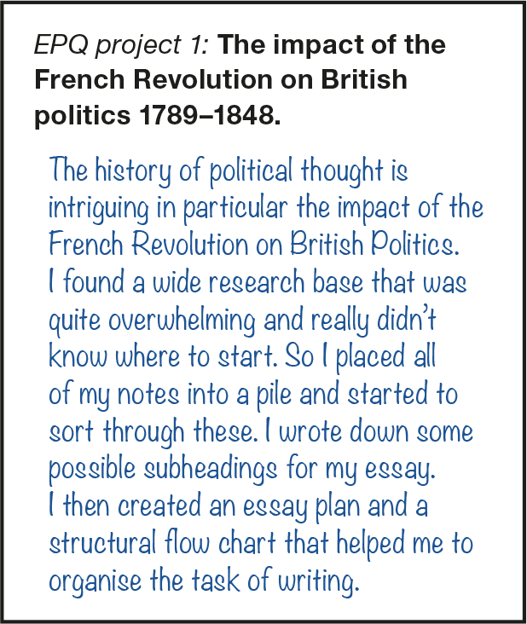
Where do I begin?
Lesson 18 Beginning the report
1/1
Book pages 74–75
Overcoming the blank page syndrome, for example:
Think out loud.
Write the ending first.
Change location.
What else?
Set achievable objectives
Set a timer for three minutes and see how much you can write.
Try just writing five sentences.
Each day set ACHIEVABLE GOALS.
What should I write?

Slide 16
Lesson 19
Marking exercise

Slide 17
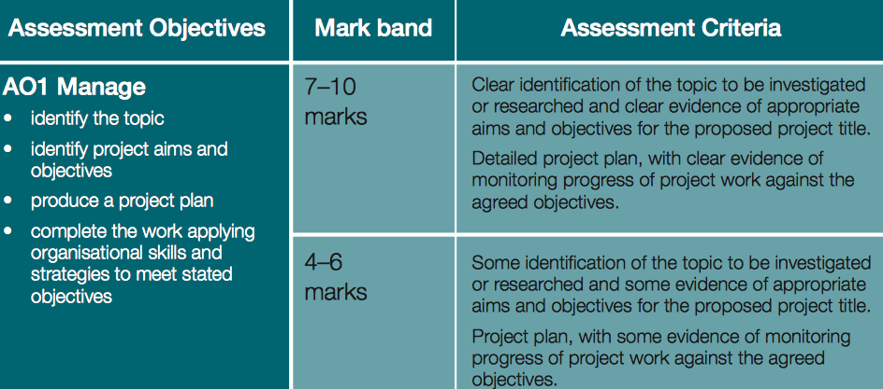
Exemplars I, II and III
Lesson 19 Marking exercise
1/1
Book pages 108–121
AQA marking criteria.
How you will be assessed:
AO1 Manage (10 marks)
AO2 Use resources (10 marks)
AO3 Develop and realise (20 marks)
AO4 Review (10 marks)
Mark the exemplars on pages 108–121.
Use the AQA markscheme: see pages 9–12 of
filestore.aqa.org.uk/subjects/AQA-W-7993-SP-15.PDF

Slide 18
Lesson 20
Writing well

Slide 19
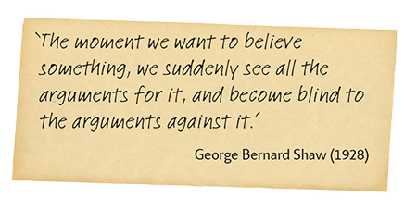
Writing fluently and critically
Lesson 20 Writing well
1/2
Book pages 76–77
Clear line of argument.
Well-structured paragraphs.
Points are based on evidence.
Both descriptive and critical analysis.
Avoid personal opinion.
Use precise language.
Avoid abbreviations and contradictions.
Use of quotations.
Making your point –
writing a POWERFUL paragraph:
Identify the point.
Justify the point.
Elaborate upon it.
Further elaboration.
Conclusion.
See exercise 4.2

Slide 20

Useful phrases
Lesson 20 Writing well
2/2
Book page 77
This suggests that …
This would imply …
So we can see …
One consequence would be …
One advantage of this is …
An alternative explanation …
Therefore …
This is challenged by …
In comparison …
In contrast …
However …
See exercise 4.3
One consequence would be ...

Slide 21
Lesson 21
Writing an abstract

Slide 22


A planner for your abstract
Lesson 21 Writing an abstract
1/2
Book pages 78–79
Abstract = A succinct summary of a piece of research.
No subheadings.
First or last?
Aim and/or hypothesis.
Relevant background literature.
Method.
Findings.
Conclusion (relate to background research).
Implications (relate to findings).
Word count 150–250 words.
See exercise 4.4
See exercise 4.5

Slide 23
Lesson 22
Writing the introduction

Slide 24
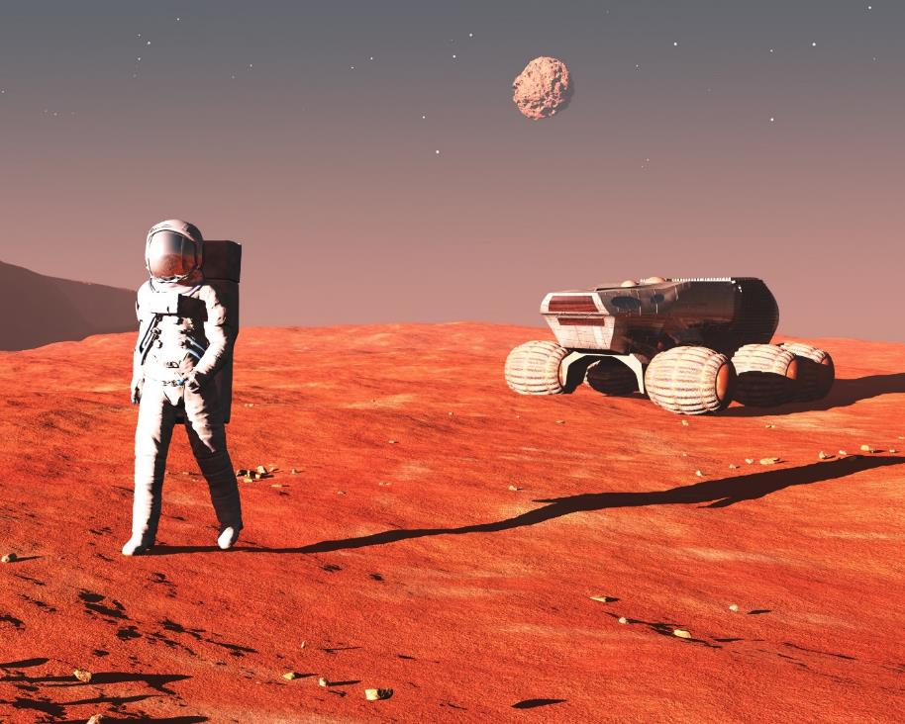

An overview
Lesson 22 Writing the introduction
1/2
Book pages 80–81
A starting point.
A topic sentence.
An attention-grabbing statement.
A brief outline.
Establish your research territory.
Establish a niche.
Background.
Scope of the work.
Word count up to 4000 words.
See exercise 4.6

Slide 25
A literature review
Lesson 22 Writing the introduction
2/2
Book pages 80–81
Relate directly to your topic.
Identify an area of controversy.
Present a summary of what we already know.
Provide a clear statement of the research questions/problems which you will be addressing.
Narrow down to the aims/hypotheses.
What order?
  Chronological.
  Thematic.

Slide 26
Lesson 23
Writing the method
(primary data and artefact only)

Slide 27

Structure for the method section of the report
Lesson 23 Writing the method
1/1
Book pages 82–83
Design.
Participants.
Materials /apparatus.
Date(s) and location.
Ethical consideration.
Procedure.
Word count 500–600 words.
See exercise 4.7
Writing your report is like writing a recipe for a cake.

Slide 28
Lesson 24
Writing the findings
(primary data only)

Slide 29
Structure FOR THE RESULTS section of the report
Lesson 24 Writing the findings
1/1
Book pages 84–85
Descriptive statistics.
Summarise.
  Quantitative data: tables and graphs.
  Qualitative data.
Inferential statistics where appropriate.
Presenting tables and figures.
Word count 500–600 words.
See exercise 4.8

Slide 30
Lesson 25
Writing the discussion

Slide 31
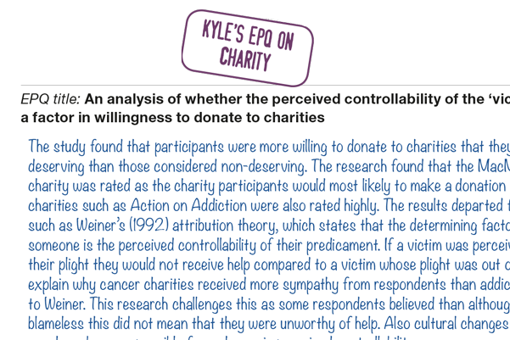
Structure FOR THE DISCUSSION section of the report
Lesson 25 Writing the discussion
1/1
Book pages 86–87
The purpose of the discussion is to consider previously mentioned research in relation to your own research. Therefore it is not expected that you will introduce new research here.
Explain the findings in relation to the hypothesis.
Explain the findings in relation to previous research.
Strengths and limitations of your project.
Implications.
Word count up to 4000 words.
See exercise 4.9

Slide 32
Lesson 26
Writing a CONCLUSION

Slide 33

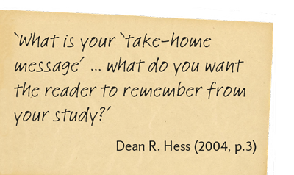
What is a take-home message?
Lesson 26 Writing a CONCLUSION
1/1
Book pages 88–89
Think about what you want people to remember.
First write in BLUNT terms → explain so it RESONATES.
Don’ts, e.g.:
End with a lengthy quotation.
Say ‘in conclusion’.
Introduce a new idea.
Do use:
In fact …
For these reasons … etc
Word count about 300 words.
See exercise 4.10
Generic structure
Brief recap.
Reference to larger issue.
Highlight key aspects.
Evaluate main arguments.
Take home message

Slide 34
Lesson 27
Editing and referencing the draft EPQ

Slide 35
Formats for referencing
Lesson 27 Editing and referencing the draft EPQ
1/3
Book pages 90–91
Book reference
Offer, D., Ostrov, E. and Howard, K. (1981). The Adolescent – a psychological self-portrait. New York: Basic Books.
Papers/articles
Milner, D. (1970). Ethnic Identity and preference in minority-group children. In: H. Tajfel, (1981) Human groups and social categories. Cambridge: Cambridge University Press, pp.329–356.
Journal articles
MacKay, G. (2002). The disappearance of disability? Thoughts on a changing culture. British Journal of Special Education, 29 (4), 159–163.
Internet pages
Jackson, R. (2004). Inclusion: A flawed Vision. GSSPL [online]. Available at: www.gssp1.org.uk/html/inclusion_aflawed-vision [Accessed January 2014].
Other types
Personal communication.
See exercise 4.11

Slide 36
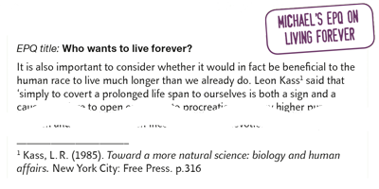
Endnotes and footnotes
Lesson 27 Editing and referencing the draft EPQ
2/3
Book page 90
A sequential number is placed in the text where you would normally put (Milner 1970).
Endnotes – end of chapter.
Footnotes – at bottom of the page.
Word processors will do it for you.
Exemplar using footnotes

Slide 37


Editing the draft EPQ
Lesson 27 Editing and referencing the draft EPQ
3/3
Book pages 92–93
Checklist – am I done?
This is not a list to just tick things off.
See exercise 4.2
^{You have finished the report!}

Slide 38
Lesson 28
Preparing the PROJECT PRODUCT REVIEW

Slide 39
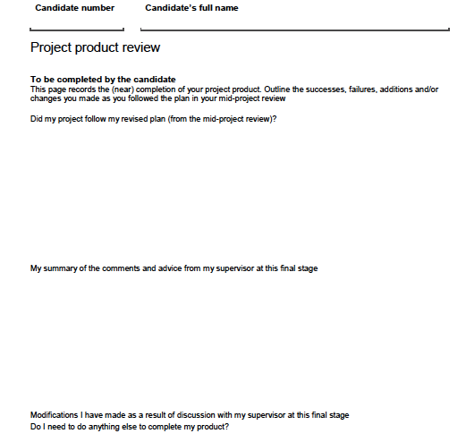
Good and bad practice
Lesson 28 Preparing the PROJECT PRODUCT REVIEW
1/1
Book pages 28–29, 37
Page 11 of the EPQ candidate record.
Examples of good practice
Kim’s project (page 28),
and Wesley’s project (page 37).
Example of bad practice
Robert’s project (page 29).

Slide 40
Lesson 29
Preparing the PRESENTATION

Slide 41

Different types of visual aids
Lesson 29 Preparing the PRESENTATION
1/4
Book pages 96–97
To non-specialist audience.
Demonstrates AO1 (planning), AO2 (use of resources), AO3 (develop and realise).
Microsoft PowerPoint.
Video, DVD, YouTube.
Interactive white board.
Non-interactive board.
Paper handouts.
Flip chart.
Artefact or props.
Market place display.
A poster presentation.
See exercise 5.1

Slide 42

Presentation skills
Lesson 29 Preparing the PRESENTATION
2/4
Book pages 98–99
Preparation beforehand
Know your material.
Use notes to support the style of your presentation.
Rehearse.
It’s no laughing matter.
On the day
Where to start.
The glass is always half full.
Be polite and assertive.
Pump up the volume?
Pace yourself.
Mind your language.
Don’t forget to breathe.
Connect with your audience!
See exercise 5.2

Slide 43
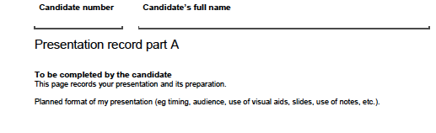
Questions and checklist
Lesson 29 Preparing the PRESENTATION
3/4
Book pages 100–101
Dealing with questions asked.
You are assessed on responses to questions from the audience.
Anticipate the questions and prepare.
Checklist and then …
Fill in PRESENTATION RECORD PART A (Page 12 of the EPQ candidate record).
An exemplar is on page 101.
See exercise 5.3

Slide 44
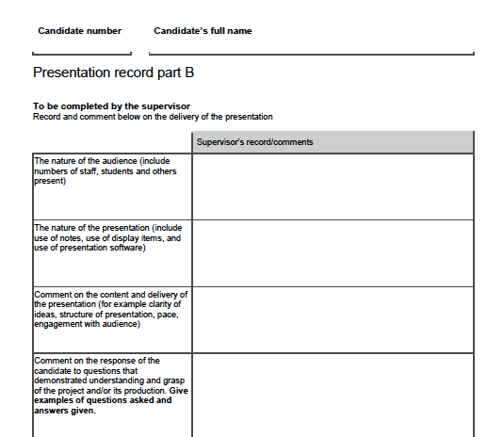
Assessing the presentation
Lesson 29 Preparing the PRESENTATION
4/4
Book pages 102–103
You can include a presentation feedback form in your PRESENTATION RECORD PART B for the moderator.
Audibility.
Pace.
Fluency.
Tone and energy.
Eye contact.
Body language and posture.
Appropriateness to the audience.
Structure and cohesion.
Use of visual aids.
Verbal content.
Response to questions.
PRESENTATION RECORD PART B –
filled in by your supervisor.
See exercise 5.4

Slide 45
Lesson 30
Writing the SUMMARY and REFLECTION

Slide 46
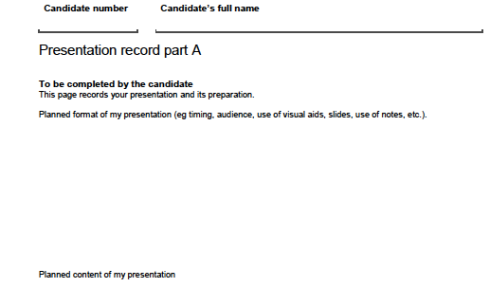
The summary
Lesson 30 Writing the SUMMARY and REFLECTION
1/3
Book pages 104–105
Brief recap of what you have covered in relation to the essay title.
Reference to the larger issue.
Highlight the important aspects.
Evaluate the main arguments.
The take-home message.
See exercise 5.5

Slide 47
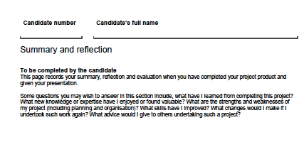
Writing a reflection
Lesson 30 Writing the SUMMARY and REFLECTION
2/3
Book pages 106–107
What have you have learned from completing your project?
What new knowledge or expertise have you found valuable?
What are the strengths and weaknesses of your project?
What skills have you improved?
What changes would you make if you undertook the work again?
What advice would you give to others undertaking such a project?
Fill in SUMMARY AND REFLECTION after the presentation.
Page 14 of the EPQ candidate record.
See exercise 5.6

Slide 48

Congratulations – You’re done
Lesson 30 Writing the SUMMARY and REFLECTION
3/3

