Slide 1


Slide 2

Lesson 1
Introducing the EPQ

Slide 3

Introducing The EPQ
Lesson 1 Introducing the EPQ
1/4
Book page 4
What is the EPQ?
The Extended Project Qualification.
Equivalent to half of an A-level.
Part of Advanced Diploma or Baccalaureate.
Taken alongside an A-level or BTEC programme.
Value of the EPQ?
Independent work.
Self-guided.

Slide 4

The benefits of the EPQ
Lesson 1 Introducing the EPQ
2/4
Book page 4
Working with others.
Working to deadlines.
Planning and management of a project.
Decision making and problem solving.
Presentation skills.
Communication skills.
Plus:
Learn skills for University-level study.
Achieve UCAS points without sitting an exam.
See exercise 0.1
UCAS Points
The EPQ tariff
A* 28
A 24
B 20
C 16
D 12
E 8

Slide 5
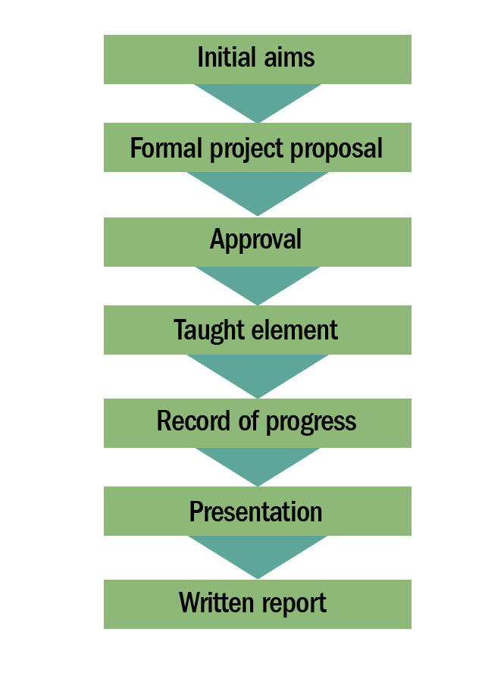
EPQ at a glance
Lesson 1 Introducing the EPQ
3/4
Book page 5
Individual or group?
Individual submission.
Format?
Written report, essay, artefact, play …
Topic?
Cannot be directly related to your studies (dual accreditation).
Taught element (30 hours) and independent work (90 hours).

Slide 6



EPQ in more detail
Lesson 1 Introducing the EPQ
4/4
Book pages 6–7
AO1 Manage the project: Clear aims and objectives, evidence of planning.
AO2 Use resources: Well-focused research.
AO3 Develop and realise: Autonomy, clear plan, well-written report, evidence of the journey.
AO4 Review: Reflecting on what you have learned.
Material that is assessed:
PRODUCTION LOG.
Written REPORT.
Record of the PRESENTATION.
See exercise 0.2
Your supervisor helps you through your project and marks the final version.
The centre coordinator oversees the whole process.
An external moderator checks the marks given by your supervisor.

Slide 7
Lesson 2
Ideas for a topic title

Slide 8

The taught element
Lesson 2 Ideas for a topic title
1/3
Book pages 10–11
EPQ takes about 120 hours, taught element = 30 hours:
Safety skills.
ICT skills.
Research skills.
Project management skills.
Personal, learning, thinking skills.
Sub-specific skills.
See suggested scheme of work on page 11.

Slide 9



Project ideas from the past
Lesson 2 Ideas for a topic title
2/3
Book pages 12–13
Extending your studies.
An artefact.
A newspaper article or TV programme.
Doing own research on a topic you’d like to study at University.
A performance.
Cross-curricular topic.
Examples of good evaluative titles
Should the care of those suffering with Alzheimer’s disease be the responsibility of government?
How to raise a thousand pounds for a local charity.
Can I design and make a platform shoe in the style of the 1970s?
See exercise 1.2

Slide 10

Things to avoid
Lesson 2 Ideas for a topic title
3/3
Book pages 14–15
Overly ambitious topics.
Emotive issues.
Where you have a personal axe to grind.
Socially sensitive topics.
Dual accreditation.
Don’t try to be too original.
Avoid being too narrow or too broad.
See exercise 1.3

Slide 11
Lesson 3
A preliminary literature review

Slide 12
Drilling down
Lesson 3 A preliminary literature review
1/2
Book page 16
A literature review = a systematic consideration of what other people have written or said about your chosen topic.
Literature = books, magazines, websites, TV programmes …
Use this preliminary literature review later when completing the
PART A: CANDIDATE PROPOSAL form.
Example:

Slide 13
A flowchart for doing your preliminary literature review
Lesson 3 A preliminary literature review
2/2
Book pages 16–17
See exercise 1.4

Slide 14
Lesson 4
Writing the CANDIDATE PROPOSAL

Slide 15

The pre-project proposal form
Lesson 4 Writing the CANDIDATE PROPOSAL
1/5
Book page 18
You have now:
Completed some preliminary research.
Selected a topic.
Time to formally propose your project so it can be approved.
WHO is affected by the topic?
WHAT are the major questions for this topic?
WHERE is your topic important?
WHEN is your topic important?
See exercise 1.5
Felix, who did the EPQ on Fracking.

Slide 16
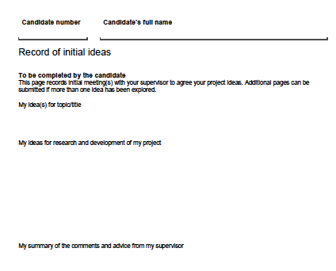
Constructing the RECORD OF INITIAL IDEAS
Lesson 4 Writing the CANDIDATE PROPOSAL
2/5
Book pages 19–20
The RECORD OF INITIAL IDEAS (page 5 of the EPQ candidate record).
STEP 1: Fill in the first two elements.
STEP 2: Discuss your ideas with your supervisor.
STEP 3: Record your supervisor’s comments on the form.
STEP 4: Modify your ideas and record your changes.

Slide 17

Constructing PART A: CANDIDATE PROPOSAL
Lesson 4 Writing the CANDIDATE PROPOSAL
3/5
Book page 21
STEP 5:
PART A: CANDIDATE PROPOSAL (page 6 of the EPQ candidate record).
Beforehand: arrange an interim meeting with supervisor.
PART B: SUPERVISOR’S COMMENTS ON CANDIDATE PROPOSAL filled in by supervisor (page 7).
PART C: CENTRE COORDINATOR’S APPROVAL OF CANDIDATE PROPOSAL filled in by centre coordinator (page 8).
See next slide for copies of forms.
Harriet did an EPQ on the Olympics.

Slide 18
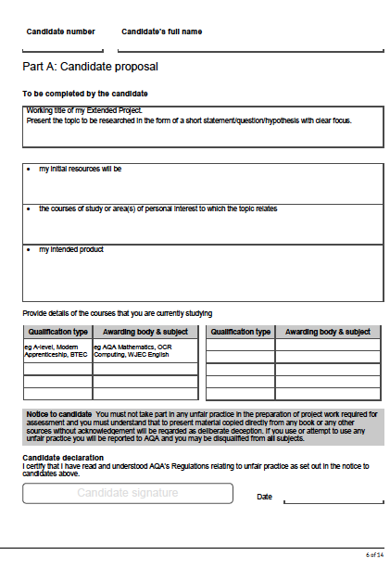
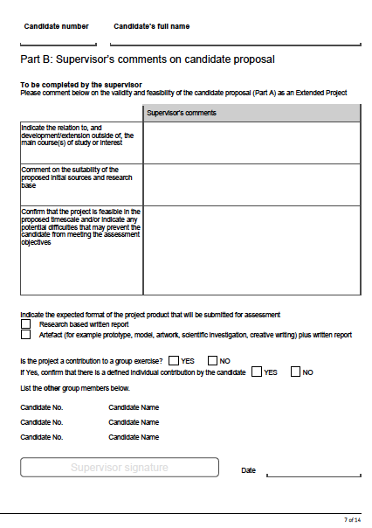
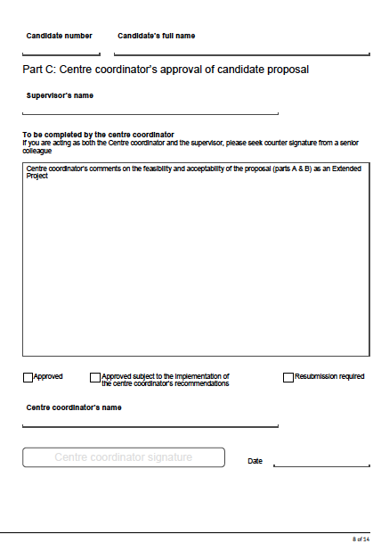
Lesson 4 Writing the CANDIDATE PROPOSAL
4/5
Book page 21

Slide 19


The role of your supervisor
Lesson 4 Writing the CANDIDATE PROPOSAL
5/5
Book pages 22_23
DO set ground rules.
DO take responsibility.
DO use the support effectively.
YOU arrange the meetings.
Make checklist of what has to be done with supervisor.
Record supervisor’s comments.
DON’T go it alone.
DON’T let your supervisor be too directive.
DON’T be disorganised.
See exercise 1.6
Your supervisor.
Don't be a puppet.

Slide 20
Lesson 5
Introducing the PRODUCTION LOG and the reviewing process

Slide 21

The PRODUCTION LOG
Lesson 5 Introducing the PRODUCTION LOG and the reviewing process
1/2
Book page 26
The EPQ is not about the PRODUCT – it’s about the PRODUCTION LOG.
The documents in the PRODUCTION LOG demonstrate your EPQ journey:
RECORD OF INITIAL IDEAS.
PARTS A, B, C: CANDIDATE PROPOSAL.
PLANNING REVIEW.
MID-PROJECT REVIEW.
PROJECT PRODUCT REVIEW.
PRESENTATION RECORD.
SUMMARY AND REFLECTION.
(Described on next slide.)

Slide 22
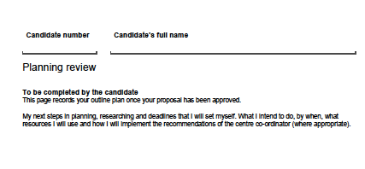
The review documents
Lesson 5 Introducing the PRODUCTION LOG and the reviewing process
2/2
Book pages 27–29
PLANNING REVIEW
Next steps in planning.
Supervisor’s advice.
Modifications made.
MID-PROJECT REVIEW
How your project has developed.
Supervisor’s advice.
Modifications made.
Final title.
Next steps.
PROJECT PRODUCT REVIEW
Was revised plan followed?
Supervisor’s advice.
Modifications made.

